Slide 1
PROFESSOR VELAZQUEZ
INTRODUCTION
TO
MICROECONOMICS
MODULE 10 · PROFIT MAXIMIZATION
FALL 2025

Slide 2
10
Profit Maximization
Module 9 gave you the cost curves. This module adds REVENUE, derives the single rule that governs every output decision — MR = MC — and follows it to its conclusions: the short-run supply curve, the long-run zero-profit result, and the deadweight loss of monopoly.
MODULE

Slide 3
MODULE 10
Agenda, Big Questions & Opening Inquiry
BIG QUESTIONS
PRE-WORK
WHAT YOU'LL NEED
(1) What are the conditions of perfect competition, and how do they determine a firm's pricing power?
(2) How does the profit-maximization rule (MR = MC) operate — and what does it predict about output, price and profit?
(3) How does monopoly power change market efficiency?
(4) Why do entry and exit drive economic profit to zero in the long run — and what survives that process?
· Read Chapters 14–15 (Firms in Competitive Markets; Monopoly)
· Review Module 9 IN FULL — every cost curve today comes from it
· Khan Academy: Perfect Competition Model, Quizzes 2 and 3 — reach mastery
· Bring the Module 10 Worksheet, a calculator and graph paper
· Module 10 Worksheet (printed)
· Calculator for the AT&T and Ray's cold storage algebra
· Graph paper — SIX labeled diagrams today
· Your Module 4 notes on consumer surplus and deadweight loss
OPENING INQUIRY
How does a firm decide how much to produce? The answer is PRECISE: produce until the revenue from the last unit exactly equals its cost. This module derives that rule, applies it across every profit scenario, and traces the long-run forces that drive economic profit to zero.
SECTION I — PERFECT COMPETITION | SECTION II — MONOPOLY
Part 1 · The conditions of perfect competition and the price-taker result Part 2 · Deriving and applying MR = MC Part 3 · Profit, loss and shutdown; the short-run supply curve Part 4 · Long-run equilibrium: entry, exit and zero economic profit | Part 5 · Monopoly characteristics; MR bisects demand; price discrimination Part 6 · Comparing competitive and monopoly equilibria; the deadweight loss of monopoly; the antitrust arc from AT&T to Google
INTRO TO MICROECONOMICS | PROF. VELAZQUEZ
MODULE 10: PROFIT MAXIMIZATION

Slide 4
BEFORE WE BEGIN
Vocabulary Checklist — Module 10
Perfect Competition — 4 assumptions
Price Taker
Market Price (P)
Total Revenue (TR)
Marginal Revenue (MR)
Average Revenue (AR)
MR = P in competition
Profit Maximization Rule (MR = MC)
Economic vs. Accounting Profit
Normal Profit
Break-Even Point
Shutdown Condition (P < AVC)
Short-Run Supply Curve
Firm vs. Market
Long-Run Equilibrium
Zero Economic Profit
Entry & Exit Dynamics
Productive Efficiency
Allocative Efficiency
Barriers to Entry
Monopoly
Market Power
Price Maker
MR < P in monopoly
Demand = AR (monopoly)
Deadweight Loss of Monopoly
Natural Monopoly
Price Discrimination
1st / 2nd / 3rd Degree
Arbitrage
THE ONE RULE THIS WHOLE MODULE RESTS ON
EVERY firm — competitive, monopolistic, oligopolistic — maximizes profit at MR = MC. What DIFFERS between market structures is not the rule but the SHAPE OF MR: horizontal at P for a price taker, and strictly below the demand curve for a price maker.
INTRO TO MICROECONOMICS | PROF. VELAZQUEZ
MODULE 10: PROFIT MAXIMIZATION

Slide 5
SECTION I
The Competitive Firm
Part 1 · The four conditions of perfect competition and why they force MR = P
Part 2 · Deriving the MR = MC profit-maximization rule
Part 3 · Profit, loss and shutdown; deriving the short-run supply curve
Part 4 · Long-run equilibrium: entry, exit, and the zero-economic-profit result

Slide 6
01
Perfect Competition
& the Price-Taker Condition
PART
OBJECTIVE Enumerate and evaluate each condition of perfect competition; establish why P = MR follows necessarily for a price taker.
INTRO TO MICROECONOMICS | PROF. VELAZQUEZ
MODULE 10: PROFIT MAXIMIZATION

Slide 7
PART 1 · THE FOUR CONDITIONS
What Perfect Competition Requires
CONDITION | PRECISE DEFINITION | DEGREE TO WHICH MARCUS'S MARKET SATISFIES IT
MANY BUYERS AND SELLERS | So many that no single participant's quantity decision perceptibly moves the market price. Each is infinitesimal relative to the market. | PARTIALLY. There are many street-food vendors and very many buyers in Philadelphia — but within a two-block lunch radius there may be only three or four sellers, and that is the market Marcus actually faces.
HOMOGENEOUS (IDENTICAL) PRODUCT | Buyers regard every seller's output as a perfect substitute. There is no brand, no reputation, no differentiation of any kind. | WEAKLY. Food is inherently differentiated — recipe, speed, location, the vendor's manner. Any differentiation gives a sliver of price-setting power, which is why this is really MONOPOLISTIC COMPETITION.
FREE ENTRY AND EXIT | No legal, technological or financial barrier to entering or leaving the industry. Capital can move in and out costlessly. | PARTIALLY. Carts are cheap relative to a factory — but permits are capped and slow, prime pitches are scarce, and Module 7's credit desert means the $2,400 of capital is itself a barrier for some.
PERFECT INFORMATION | All buyers and sellers know all prices and all product qualities, at no cost. | WEAKLY. Buyers do not price-check every cart; they buy from the one they can see. Search costs are exactly what gives a vendor local pricing power.
For a PRICE TAKER: MR = ΔTR / ΔQ = Δ(P × Q) / ΔQ = P (because P is CONSTANT)
A price taker cannot influence the market price because its own output is a NEGLIGIBLE FRACTION of total market supply.
Every unit sells at the same price P, so the revenue added by the last unit is exactly P. Hence MR = AR = P = d.
WHY WE STILL USE A MODEL THAT NO REAL MARKET SATISFIES
Perfect competition is a BENCHMARK, not a description. Its value is that it defines the efficient outcome precisely — so that every real market can be measured by HOW FAR IT DEPARTS from it, and in which direction. Module 11 will occupy the space in between.
INTRO TO MICROECONOMICS | PROF. VELAZQUEZ
MODULE 10: PROFIT MAXIMIZATION

Slide 8
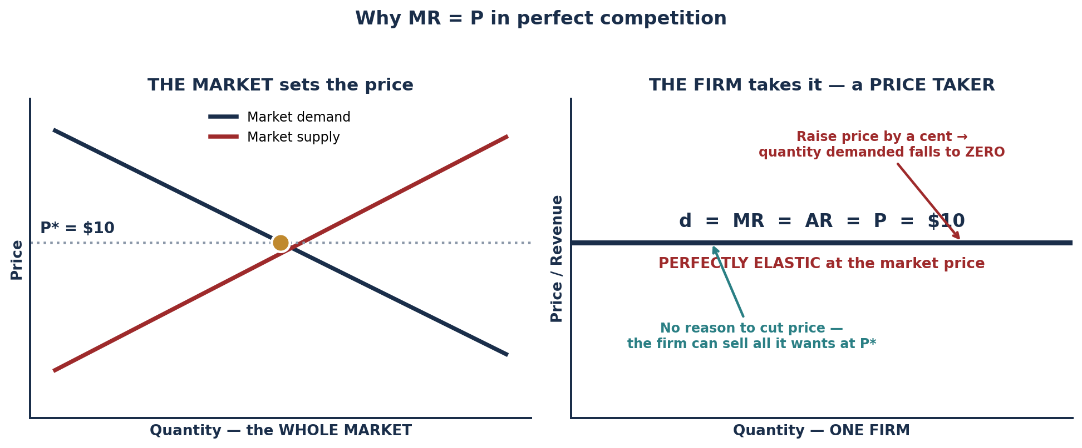
SCENARIO · MARCUS'S FOOD CART
Total Revenue, Marginal Revenue and the Price-Taker Result
Suppose Marcus operates in a perfectly competitive street-food market. The market price for his lunch special is $10.
MEALS (Q) | PRICE (P) | TR = P × Q | MR = ΔTR/ΔQ | P = MR?
0 | $10 | $0 | — | —
1 | $10 | $10 | $10 | YES
2 | $10 | $20 | $10 | YES
3 | $10 | $30 | $10 | YES
4 | $10 | $40 | $10 | YES
5 | $10 | $50 | $10 | YES
WHY THE RESULT HOLDS
Because in perfect competition EVERY UNIT IS SOLD AT THE SAME MARKET PRICE. Selling the fifth meal does not require cutting the price on the first four — so the revenue added by the fifth meal is the full $10.
Contrast Part 5, where a monopolist must cut price on ALL units to sell one more.
THREE NAMES, ONE LINE
The firm's demand curve d, its MARGINAL revenue MR, and its AVERAGE revenue AR are all the same horizontal line at P. This is true ONLY under price-taking.
INTRO TO MICROECONOMICS | PROF. VELAZQUEZ
MODULE 10: PROFIT MAXIMIZATION

Slide 9
02
The MR = MC
Profit-Maximization Rule
PART
OBJECTIVE Derive the profit-maximization rule; identify optimal output from a cost and revenue schedule; compute profit.
INTRO TO MICROECONOMICS | PROF. VELAZQUEZ
MODULE 10: PROFIT MAXIMIZATION

Slide 10
PART 2 · THE GOLDEN RULE
Why MR = MC Maximizes Profit
THE GOLDEN RULE: produce where MR = MC
In PERFECT COMPETITION, MR = P — so the competitive firm produces where P = MC.
Beyond this point, each additional unit costs MORE to produce than it earns.
MARGINAL REVENUE (MR)
MARGINAL COST (MC)
THE LOGIC IN TWO LINES
The additional REVENUE from selling one more unit.
MR = ΔTR / ΔQ.
For a price taker it is constant at P. For a price maker it FALLS as Q rises (Part 5).
The additional COST of producing one more unit.
MC = ΔTC / ΔQ.
It RISES once diminishing returns set in — Module 9, and the reason MC = W/MP.
IF MR > MC → PRODUCE MORE. The unit earns more than it costs, so making it ADDS to profit.
IF MR < MC → PRODUCE LESS. The unit costs more than it earns, so making it SUBTRACTS from profit.
Maximum profit is where the two are exactly equal.
✦1 THE RULE IN PURELY INTUITIVE TERMS
The calculus version finds where the SLOPE of TR equals the SLOPE of TC — the point at which the vertical gap between them is widest. But you do not need calculus to see it.
THINK OF EACH UNIT SEPARATELY. Every unit either adds to the profit pile or subtracts from it. A unit adds if MR > MC and subtracts if MC > MR. A rational firm therefore makes EVERY unit that adds and NO unit that subtracts. The last unit worth making is the one where the addition is exactly zero — which is precisely MR = MC.
Producing when MR > MC always raises profit because you are leaving money on the table by stopping. Producing when MC > MR always destroys profit because you are paying more for the unit than anyone will give you for it. There is no third possibility.
INTRO TO MICROECONOMICS | PROF. VELAZQUEZ
MODULE 10: PROFIT MAXIMIZATION

Slide 11
SCENARIO · IOWA CORN FARM, 1973
Applying MR = MC — and Discovering a Loss
A corn farmer faces market price P = $2.80/bu during the OPEC-era food price surge. TFC = $4,000. At Q = 2,000: ATC = $3.60 and AVC = $1.60.
THE SHUTDOWN CHECK
QUANTITY (bu) | MC | MR = P | MR vs. MC
1,000 | $1.80 | $2.80 | MR > MC → produce more
1,500 | $2.20 | $2.80 | MR > MC → produce more
2,000 | $2.80 | $2.80 | MR = MC → Q* = 2,000
2,500 | $3.50 | $2.80 | MC > MR → do not produce
3,000 | $4.20 | $2.80 | MC > MR → do not produce
AVC at Q = 2,000 is $1.60. Is P ≥ AVC?
YES — $2.80 ≥ $1.60. Every bushel covers its own variable cost and contributes $1.20 toward the fixed cost.
DECISION: PRODUCE AND LOSE MONEY.
OPTION | THE ARITHMETIC | LOSS
PRODUCE 2,000 bu | TR = 2.80 × 2,000 = $5,600. TC = 3.60 × 2,000 = $7,200. | −$1,600
SHUT DOWN | TR = $0. TC = TFC = $4,000, still owed. | −$4,000
π = (P − ATC) × Q = (2.80 − 3.60) × 2,000 = −$1,600
P < ATC, so the farm is making an ECONOMIC LOSS at its best possible output.
THE LESSON
MR = MC does NOT mean 'make a profit'. It means 'do the BEST YOU CAN, given the price'. Sometimes the best you can do is lose $1,600 instead of $4,000.
This is why Module 9's distinction between AVC and ATC matters so much: MR = MC finds the optimal QUANTITY, and the AVC comparison decides whether to produce that quantity AT ALL.
INTRO TO MICROECONOMICS | PROF. VELAZQUEZ
MODULE 10: PROFIT MAXIMIZATION

Slide 12
SCENARIO · RAY'S WAREHOUSE
A Complete Revenue and Cost Schedule
Market price P = $80 per unit. Apply MR = MC to find profit-maximizing output and compute total economic profit.
Q | TR = P × Q | TC | MR | MC | PROFIT = TR − TC | PRODUCE? (MR ≥ MC)
0 | $0 | $200 | — | — | −$200 | —
1 | $80 | $260 | $80 | $60 | −$180 | YES — MR > MC
2 | $160 | $310 | $80 | $50 | −$150 | YES — MR > MC
3 | $240 | $350 | $80 | $40 | −$110 | YES — MR > MC
4 | $320 | $400 | $80 | $50 | −$80 | YES — MR > MC
5 | $400 | $470 | $80 | $70 | −$70 ← BEST | YES — the LAST profitable unit
6 | $480 | $560 | $80 | $90 | −$80 | NO — MC > MR
7 | $560 | $680 | $80 | $120 | −$120 | NO — MC > MR
Q* = 5
Max π = −$70
IT IS A LOSS — AND STILL OPTIMAL
MR = MC between Q = 5 and Q = 6: MC(5) = $70 < $80, MC(6) = $90 > $80. So the fifth unit is the last one worth making.
−$70 is the SMALLEST loss available. Every other row is worse.
CHECK THE SHUTDOWN RULE
WHY MR = MC MAXIMIZES PROFIT — STATED WITH THIS TABLE
TFC = TC at Q = 0 = $200.
At Q = 5: TVC = 470 − 200 = $270, so AVC = $54.
P = $80 > AVC = $54 → OPERATE. The loss of $70 beats the shutdown loss of $200.
IF MR > MC, PRODUCE MORE: at Q = 3 the fourth unit adds $80 of revenue and $50 of cost, so the loss shrinks by $30. IF MC > MR, PRODUCE LESS: at Q = 6 the sixth unit adds $80 of revenue and $90 of cost, so the loss grows by $10. The optimum is the last unit for which the addition is still non-negative.
INTRO TO MICROECONOMICS | PROF. VELAZQUEZ
MODULE 10: PROFIT MAXIMIZATION

Slide 13
03
Profit, Loss, Shutdown
& the Short-Run Supply Curve
PART
OBJECTIVE Compute and graphically illustrate each profit scenario; derive the shutdown condition; build the short-run supply curve from the MC curve.
INTRO TO MICROECONOMICS | PROF. VELAZQUEZ
MODULE 10: PROFIT MAXIMIZATION

Slide 14
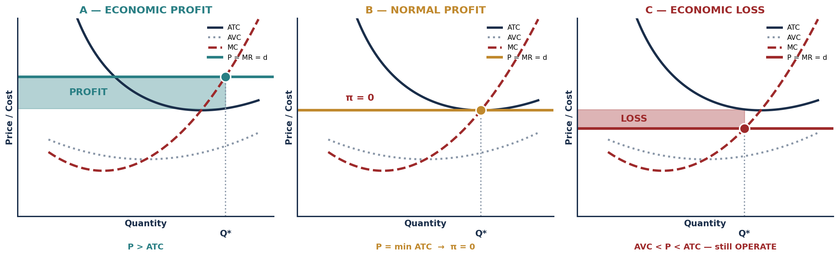
PART 3 · THE THREE CASES
Profit, Normal Profit and Loss — All at MR = MC
CASE | CONDITION (PRICE vs. COSTS) | RULE | PRODUCE OR NOT?
PROFIT | P > ATC | Produce where MR = MC | YES — earn positive ECONOMIC PROFIT
BREAK-EVEN / NORMAL PROFIT | P = min ATC | Produce where MR = MC | YES — economic profit is ZERO, which means the firm is earning exactly its opportunity cost
LOSS-MINIMIZE | AVC < P < ATC | Produce where MR = MC | YES — covering all VARIABLE costs plus a contribution to fixed; fixed costs are sunk in the short run
SHUTDOWN | P < AVC | Produce ZERO units | NO — losing MORE by staying open than by closing
INTRO TO MICROECONOMICS | PROF. VELAZQUEZ
MODULE 10: PROFIT MAXIMIZATION

Slide 15
SCENARIO · MARCUS, MONTH 3
Accounting Profit, Economic Profit and the Verdict
Marcus reviews Month 3: TR = $1,800; explicit costs (VC + FC) = $1,400; implicit cost — the forgone wage at Ray's warehouse — = $600/month.
THE SHUTDOWN CONDITION — why AVC and not ATC
ACCOUNTING PROFIT = 1,800 − 1,400 = +$400
ECONOMIC PROFIT = 1,800 − (1,400 + 600) = −$200
A firm shuts down when P < AVC because at prices below AVC it cannot cover even its VARIABLE costs — so operating DEEPENS the loss beyond the fixed costs it would owe anyway.
Fixed costs are owed whether the firm operates or not. They therefore cannot influence the decision.
WHY OPERATE WHEN AVC < P < ATC
Because revenue covers ALL variable cost AND contributes something toward the fixed cost. Shutting down would forfeit that contribution and leave the whole fixed cost uncovered.
The firm loses money either way — it simply loses LESS by staying open.
THE VERDICT
By the accountant's measure Marcus is doing fine. By the economist's measure he is $200/month WORSE OFF than simply working at Ray's warehouse.
On these numbers alone he should NOT continue: his time has a better use, and the cart is destroying $200 of value a month.
SHORT-RUN SUPPLY = the MC curve ABOVE min AVC
Not above ATC. Above AVC.
BUT READ THE CAVEAT HONESTLY
This is ONE month's data, and the gap is small. If the cart is still building a customer base, the relevant comparison is EXPECTED FUTURE profit, not Month 3. The rule is right; the input may not be representative yet.
SCENARIO — MARCUS'S SHUTDOWN MONTH
P = $3.50, AVC = $4.00, ATC = $9.33. Is P > AVC? NO. → SHUT DOWN in the short run. Closed, he loses only his FIXED costs. Open, he loses fixed costs PLUS $0.50 on every meal he serves.
INTRO TO MICROECONOMICS | PROF. VELAZQUEZ
MODULE 10: PROFIT MAXIMIZATION

Slide 16
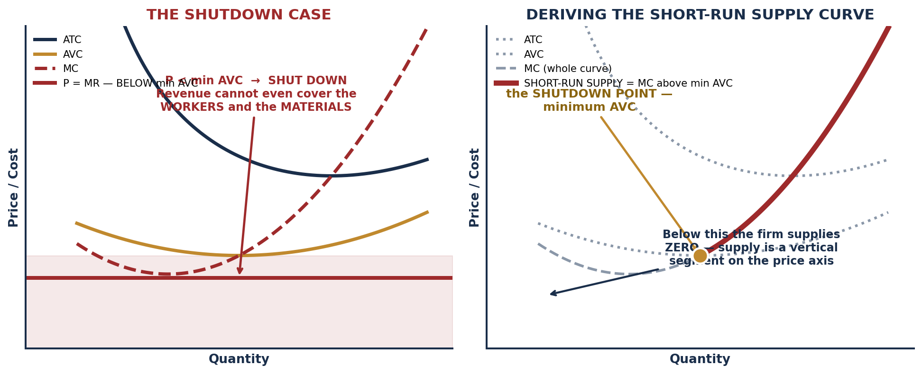
PART 3 · DERIVING SUPPLY
The Shutdown Case and the Short-Run Supply Curve
✦2 WHY A LOSS-MAKING FIRM SOMETIMES SHOULD KEEP OPERATING
IN PLAIN LANGUAGE: the rent is due whether or not you open the doors. If opening brings in more than the cost of the food and the wages, then every dollar above that goes toward the rent you owe regardless. Closing does not save the rent — it only loses the contribution.
THE PRECISE CLOSING POINT: when the price no longer covers the AVERAGE VARIABLE cost. At that moment each additional unit sold makes things WORSE, and the only way to cap the loss at the fixed cost is to produce nothing.
FOR MARCUS MONTH TO MONTH: as long as the price of a meal exceeds the $4 of ingredients and gas, serve meals — even in a losing month. When it does not, stay home. And if he expects price never to exceed ATC again, that is the LONG-RUN exit decision, which is a different question.
INTRO TO MICROECONOMICS | PROF. VELAZQUEZ
MODULE 10: PROFIT MAXIMIZATION

Slide 17
04
Long-Run Equilibrium
& Entry/Exit Dynamics
PART
OBJECTIVE Trace the entry and exit process that drives economic profit to zero; define productive and allocative efficiency.
INTRO TO MICROECONOMICS | PROF. VELAZQUEZ
MODULE 10: PROFIT MAXIMIZATION

Slide 18
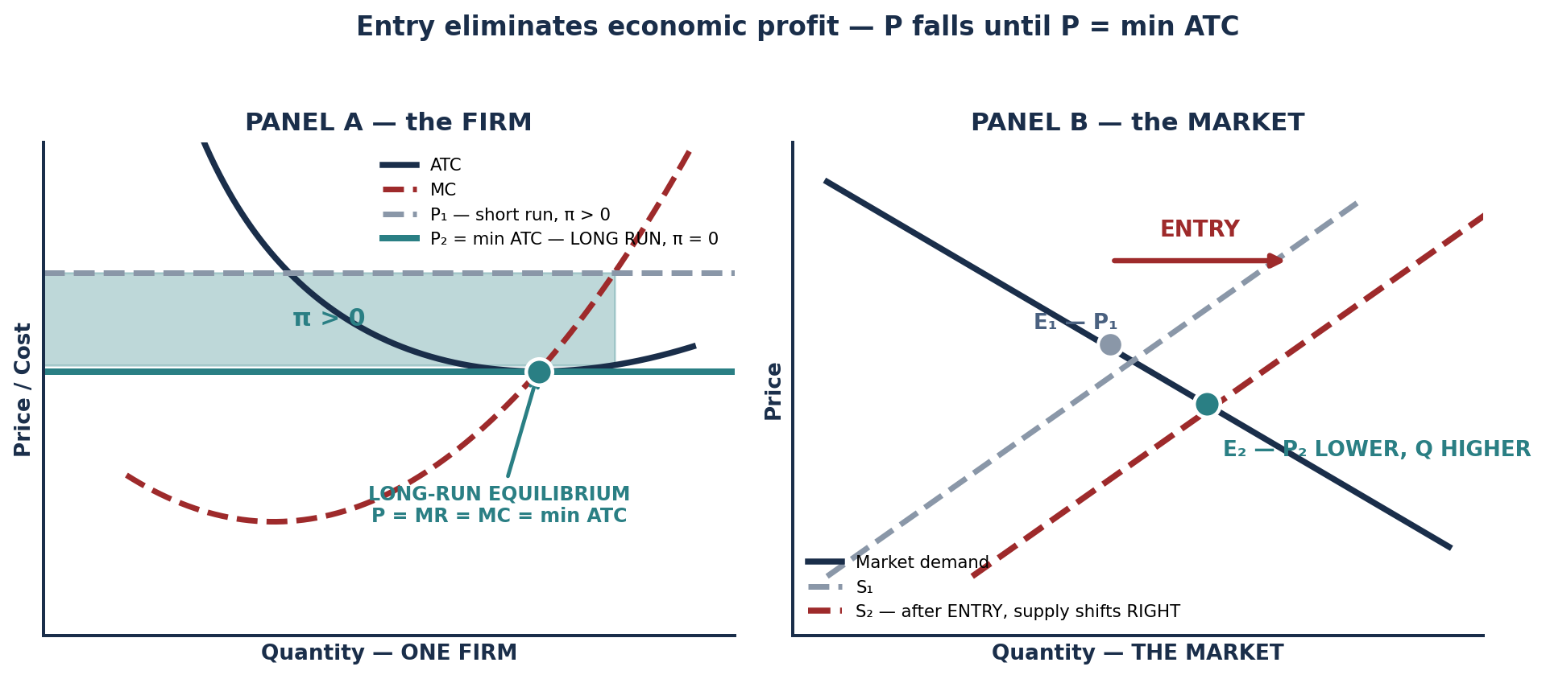
PART 4 · THE ADJUSTMENT
How Entry and Exit Eliminate Economic Profit
STARTING CONDITION | MARKET PROCESS | LONG-RUN OUTCOME
Economic profit > 0 (P > ATC) | New firms ENTER the market → market supply shifts RIGHT → P FALLS | P falls until P = min ATC and economic profit → ZERO
Economic loss (P < ATC) | Existing firms EXIT the market → market supply shifts LEFT → P RISES | P rises until P = min ATC and losses → ZERO
Normal profit (P = min ATC) | NO entry or exit incentive — the market is at rest | STABLE long-run equilibrium. Only NORMAL profit survives.
LONG-RUN RESULT: P = MR = MC = min ATC
INTRO TO MICROECONOMICS | PROF. VELAZQUEZ
MODULE 10: PROFIT MAXIMIZATION

Slide 19
PART 4 · TWO EFFICIENCIES AND WORKSHEET ✦3
What the Zero-Profit Equilibrium Achieves
PRODUCTIVE EFFICIENCY
ALLOCATIVE EFFICIENCY
P = MINIMUM ATC.
The firm is producing at the LOWEST POSSIBLE AVERAGE COST. No resources are wasted — the good is being made as cheaply as it can be made with existing technology.
P = MARGINAL COST.
Price equals the SOCIAL MARGINAL COST of production, so the value buyers place on the last unit exactly equals what it cost society to make it. No mutually beneficial trade goes unmade.
THE REMARKABLE FACT
Both efficiencies emerge from the SAME long-run condition, and neither is anyone's intention. No firm is trying to minimize cost for society or to price at marginal cost. Each is maximizing its own profit. This is the sharpest possible statement of Adam Smith's invisible hand — and it is why Module 4's three assumptions matter so much.
1
BARRIERS TO ENTRY
2
PRODUCT DIFFERENTIATION
3
CONTINUOUS INNOVATION
If entry is blocked, the mechanism cannot operate. Patents, licences, network effects, control of a scarce input, or enormous minimum efficient scale (Module 9) all prevent the supply shift that would compete the profit away.
IMPLIES: the market is NOT competitive, whatever the number of incumbents.
If products are not homogeneous, each firm has a downward-sloping demand curve and a sliver of price-setting power. Brand, reputation, location and switching costs all do this.
IMPLIES: MONOPOLISTIC COMPETITION — the subject of Module 11. Profits persist but are usually small.
A firm can keep re-establishing a temporary advantage faster than rivals can imitate it. Schumpeter's answer: the profit is real but the IDENTITY of the earner keeps changing.
IMPLIES: the market may be dynamically competitive even when it is never statically so. Also: measured 'economic profit' may partly be a return to unmeasured intangible capital.
A FOURTH, QUIETER REASON
Some apparent economic profit is really a return to a factor we failed to cost — an owner's unusual skill, a uniquely good location, a brand built over decades. Properly measured, that is ECONOMIC RENT to a scarce factor (Module 5), not profit at all.
INTRO TO MICROECONOMICS | PROF. VELAZQUEZ
MODULE 10: PROFIT MAXIMIZATION

Slide 20
SECTION II
Monopoly
Part 5 · Monopoly characteristics; why MR bisects demand; applying MR = MC; price discrimination
Part 6 · Comparing competitive and monopoly equilibria; the deadweight loss of monopoly
Part 6 · The antitrust arc: AT&T 1984 → Microsoft 1998 → Google 2024

Slide 21
05
Monopoly
PART
OBJECTIVE Derive the monopolist's MR schedule; apply MR = MC to find optimal output; compute monopoly price, profit and deadweight loss; introduce price discrimination.
INTRO TO MICROECONOMICS | PROF. VELAZQUEZ
MODULE 10: PROFIT MAXIMIZATION

Slide 22
PART 5 · THE CRITICAL DIFFERENCE
Why MR < P for a Monopolist
THE MONOPOLIST IS THE INDUSTRY
AND THAT IS WHY MR < P
With one seller, the firm's demand curve IS the MARKET demand curve — and market demand is DOWNWARD-SLOPING.
So the monopolist is a PRICE MAKER: it chooses a point on the demand curve rather than accepting a price from the market. But it cannot choose price AND quantity independently — the demand curve links them.
To sell ONE MORE unit, the monopolist must LOWER THE PRICE ON EVERY UNIT — not just on the marginal one.
So the revenue gained is the price of the new unit MINUS the revenue lost on all the units that were already selling at the higher price. That subtraction is why MR lies strictly BELOW the demand curve at every quantity.
If P = a − bQ then TR = aQ − bQ² and MR = a − 2bQ
MR has the SAME intercept as demand and TWICE the slope — which is exactly what 'MR BISECTS DEMAND' means:
the MR line cuts the horizontal distance between the vertical axis and the demand curve exactly in half at every price.
 | PERFECT COMPETITION | MONOPOLY
Firm's demand curve | HORIZONTAL at the market price | DOWNWARD-SLOPING — it is the market demand curve
Marginal revenue | MR = P (constant) | MR < P at every Q, and MR falls twice as fast as P
Profit-maximizing rule | MR = MC — so P = MC | MR = MC — but P is then read UP TO THE DEMAND CURVE, so P > MC
Long-run economic profit | ZERO — entry competes it away | CAN PERSIST — barriers to entry block the mechanism
Efficiency | Productively AND allocatively efficient | NEITHER. P > MC, and output is below min ATC
INTRO TO MICROECONOMICS | PROF. VELAZQUEZ
MODULE 10: PROFIT MAXIMIZATION

Slide 23
SCENARIO · AT&T LONG DISTANCE, 1977
Solving a Monopoly Algebraically
AT&T is the only long-distance provider. Demand: P = 2.50 − 0.0002Q. MC = $0.70 (constant). MR = 2.50 − 0.0004Q.
WHAT HAPPENS TO CONSUMER SURPLUS | COMPUTATION | VALUE
CS under COMPETITION | ½ × 9,000 × (2.50 − 0.70) | $8,100/day
CS under MONOPOLY | ½ × 4,500 × (2.50 − 1.60) | $2,025/day
CS LOST in total | 8,100 − 2,025 | $6,075/day
…of which TRANSFERRED to AT&T as profit | (1.60 − 0.70) × 4,500 | $4,050/day
…of which DESTROYED as deadweight loss | ½ × 4,500 × 0.90 | $2,025/day
MR = MC: 2.50 − 0.0004Q = 0.70
1.80 = 0.0004Q → Q* = 4,500 calls/day
P* = 2.50 − 0.0002(4,500) = $1.60
COMPETITIVE: P = MC = $0.70
0.70 = 2.50 − 0.0002Q → Q_c = 9,000
READ THE DECOMPOSITION CAREFULLY
DWL = ½ × (9,000 − 4,500) × (1.60 − 0.70) = $2,025 per day
The consumer loses $6,075/day. AT&T gains $4,050 of it — that part is a TRANSFER, not a loss to society. The remaining $2,025 is a genuine DESTRUCTION of value: calls that buyers valued above $0.70 and that cost $0.70 to carry, which simply never happened.
Only the triangle is deadweight. The rectangle is distribution.
CONSUMERS PAY $1.60 INSTEAD OF $0.70
A NOTE ON THE WORKSHEET FIGURE
The worksheet states a competitive Q of 6,000. Setting P = MC in the GIVEN demand curve yields 9,000. Use the demand curve you were given, show the algebra, and flag the discrepancy — that is the right professional response.
More than double the competitive price — and they buy half as many calls. Both effects follow from a single decision: produce where MR = MC, then price off the DEMAND curve.
INTRO TO MICROECONOMICS | PROF. VELAZQUEZ
MODULE 10: PROFIT MAXIMIZATION

Slide 24
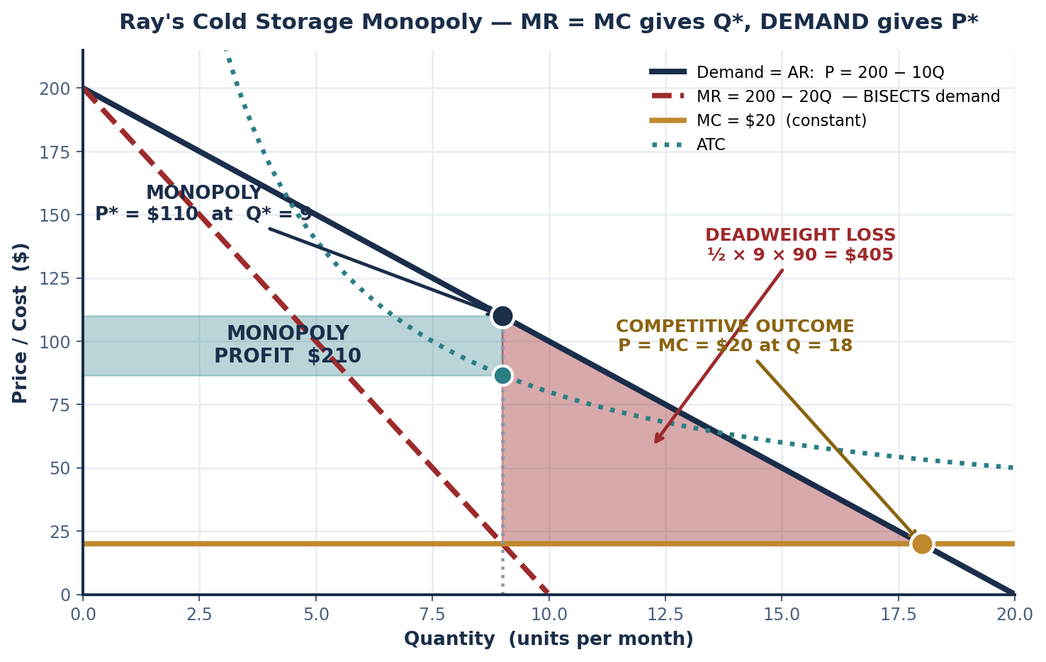
SCENARIO · RAY'S COLD STORAGE MONOPOLY
The Complete Monopoly Diagram
P = 200 − 10Q TC = 600 + 20Q
TR = 200Q − 10Q² MR = 200 − 20Q
MR = MC: 200 − 20Q = 20 → Q* = 9
P* = 200 − 10(9) = $110
Q | P | TR | MR | TC | PROFIT
5 | 150 | 750 | 110 | 700 | +50
6 | 140 | 840 | 90 | 720 | +120
7 | 130 | 910 | 70 | 740 | +170
8 | 120 | 960 | 50 | 760 | +200
9 | 110 | 990 | 30 | 780 | +210 ← MAX
10 | 100 | 1,000 | 10 | 800 | +200
THE THREE ANSWERS
ECONOMIC PROFIT = (P* − ATC) × Q* = (110 − 86.67) × 9 = $210.
COMPETITIVE OUTCOME: P = MC → 200 − 10Q = 20 → Q_c = 18 at P = $20.
DWL = ½ × (18 − 9) × (110 − 20) = $405.
MR = MC GIVES THE QUANTITY, NOT THE PRICE
The price is read UP to the DEMAND curve, never off MR. Reading P off MR is the most common monopoly error.
INTRO TO MICROECONOMICS | PROF. VELAZQUEZ
MODULE 10: PROFIT MAXIMIZATION

Slide 25
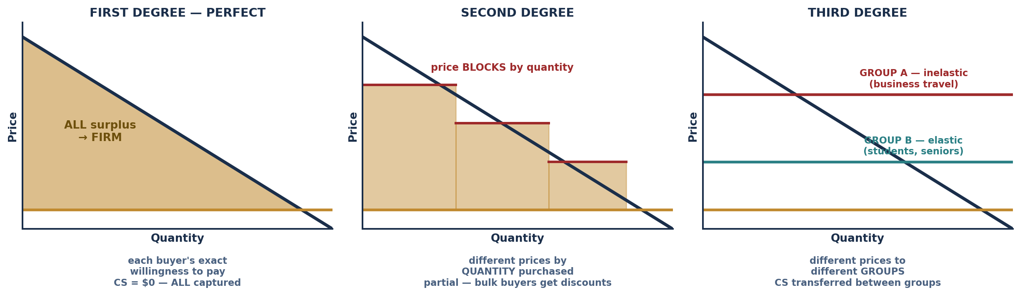
PART 5 · PRICE DISCRIMINATION
Charging Different Buyers Different Prices
PRICE DISCRIMINATION — the definition
THE TWO NECESSARY CONDITIONS
Charging different PRICES to different buyers for the SAME good, where the price differences are NOT based on cost differences.
It requires market power: a price taker cannot do it.
1. The firm must be able to SEPARATE buyer groups with different willingness to pay — and identify which group a buyer is in.
2. The firm must be able to PREVENT ARBITRAGE — buyers must not be able to resell to each other, or the low-price group simply becomes a wholesaler.
EXAMPLE | DEGREE | MECHANISM | WHO WINS / LOSES vs. UNIFORM PRICING
Amazon dynamic pricing — prices adjust ~1,000×/day on demand signals | Approaching FIRST degree | Individual-level demand estimation from browsing, location and purchase history | FIRM captures most surplus. Buyers with inelastic or urgent demand lose; bargain-hunters may gain.
Airline pricing — book early cheap, last minute expensive | SECOND and THIRD degree combined | Advance-purchase requirements and fare classes SELF-SORT business from leisure travellers | LEISURE travellers WIN (they would not fly at the uniform price). BUSINESS travellers LOSE. Total output RISES.
Drug prices — $5,000 in the U.S., $200 in India for the same medication | THIRD degree, by country | Geographic separation plus import restrictions prevent arbitrage | LOW-INCOME country patients WIN — they get the drug at all. U.S. patients LOSE and effectively fund the R&D.
Movie theaters — matinee cheaper than evening | THIRD degree, by time | Time of day sorts price-sensitive from time-constrained viewers; tickets cannot be resold across showings | MATINEE viewers WIN. Evening viewers LOSE. Seats that would sit empty are filled.
INTRO TO MICROECONOMICS | PROF. VELAZQUEZ
MODULE 10: PROFIT MAXIMIZATION

Slide 26
06
Comparing Market Efficiency
PART
OBJECTIVE Compare competitive and monopoly equilibria; calculate the deadweight loss of monopoly; connect to Module 4's welfare framework.
INTRO TO MICROECONOMICS | PROF. VELAZQUEZ
MODULE 10: PROFIT MAXIMIZATION

Slide 27
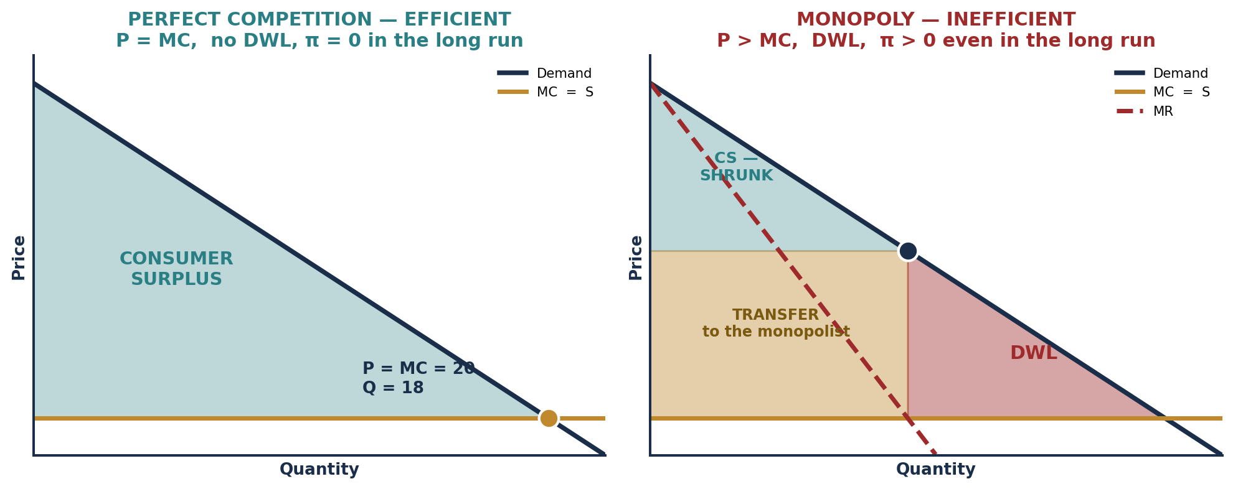
PART 6 · SIDE BY SIDE
Perfect Competition vs. Monopoly
 | PERFECT COMPETITION (long run) | MONOPOLY
Price vs. marginal cost | P = MC — ALLOCATIVELY EFFICIENT | P > MC — allocatively INEFFICIENT
Price vs. minimum ATC | P = min ATC — PRODUCTIVELY EFFICIENT | P > min ATC — productively inefficient; output is not at lowest cost
Long-run economic profit | ZERO — only normal profit survives | POSITIVE — protected by barriers to entry
Consumer surplus | MAXIMIZED | REDUCED — partly TRANSFERRED to the producer, partly DESTROYED as DWL
Deadweight loss | NONE | The triangle between Q_monopoly and Q_competitive, bounded by demand above and MC below
AT&T BEFORE AND AFTER 1984
Before: P >> MC, a large DWL, and weak incentive to innovate. After the divestiture and entry by MCI and Sprint, real cross-country call prices fell by roughly 90% over the following two decades.
INTRO TO MICROECONOMICS | PROF. VELAZQUEZ
MODULE 10: PROFIT MAXIMIZATION

Slide 28
PART 6 · SYNTHESIS
The Antitrust Arc — AT&T to Google
ERA / CASE | MARKET TYPE | KEY INEFFICIENCY | POLICY RESPONSE | DID IT WORK?
AT&T (before 1984) | NATURAL MONOPOLY — network fixed costs so large that MES exceeded market demand | P >> MC; large DWL; weak incentive to innovate in equipment or service | Regulated monopoly from 1913 (rate-of-return regulation) → structural BREAKUP in 1984 into seven regional operating companies | LARGELY YES for prices — long-distance rates fell roughly 90% in real terms. But the regional monopolies persisted locally, and much of the industry has since re-consolidated.
MICROSOFT (1998–2001) | NETWORK-EFFECTS MONOPOLY — the value of the OS rose with the number of users and applications | BUNDLING Internet Explorer with Windows to foreclose browser competition — leveraging one monopoly into an adjacent market | DOJ antitrust suit; a breakup was ordered at trial and REVERSED on appeal; settled with BEHAVIORAL remedies only (interoperability disclosure, no breakup) | PARTIALLY. IE ultimately lost to Chrome and Firefox anyway. Many argue the suit's real effect was to make Microsoft cautious enough to leave room for Google — a deterrence effect rather than a remedy effect.
GOOGLE SEARCH (2024– ) | DATA NETWORK-EFFECTS MONOPOLY — more queries produce better results, which attract more queries | 90%+ search share sustained by DEFAULT PLACEMENT agreements that exclude rivals from the point of distribution | DOJ antitrust trial; liability found in 2024; remedies contested and on appeal | TBD. The core difficulty is that the scale which produces the harm is the same scale that produces the product quality.
✦4 WOULD BREAKING GOOGLE UP RESTORE COMPETITIVE EFFICIENCY?
(1) THE BARRIER is DATA NETWORK EFFECTS reinforced by default-placement contracts — a feedback loop, not a patent or a statute. It is closest to Module 8's algorithmic loop: scale produces quality, which produces scale.
(2) THE MISSING TRADES are harder to see than AT&T's, because the consumer price is zero. The DWL is on the ADVERTISER side — advertisers paying above the competitive price — and in the QUALITY-AND-PRIVACY dimension for users, who cannot buy a better-privacy search at a competitive price because no rival has the scale to offer one.
(3) THE MODULE 9 TENSION: if LRAC falls continuously (the platform case), a breakup RAISES average cost and may degrade the product. This is the natural-monopoly problem again — which is precisely why AT&T was REGULATED for 71 years before it was broken up. Splitting a natural monopoly destroys the scale economy; regulating one preserves it but requires a regulator who can observe cost.
INTRO TO MICROECONOMICS | PROF. VELAZQUEZ
MODULE 10: PROFIT MAXIMIZATION

Slide 29
SCENARIO · MARCUS & RAY
The Same Rule, Two Structurally Different Markets
 | MARCUS — food cart (competitive) | RAY — warehouse (imperfect competitor)
Price | $10 | $80
ATC at Q* | $8 | $60
Economic profit PER UNIT (P − ATC) | $2 | $20
Q* | 200 meals/month | 50 units/month
TOTAL economic profit | $2 × 200 = $400/month | $20 × 50 = $1,000/month
Long-run trajectory | COMPETITIVE market → other vendors ENTER → supply rises → P falls toward min ATC → economic profit → ZERO | BARRIERS TO ENTRY (the property itself, permits, scale) → entry does not occur → profit MAY PERSIST INDEFINITELY
✦4 THE KEY STRUCTURAL DIFFERENCE
BOTH firms operate at MR = MC. Both are behaving identically and rationally. What differs is ENTRY.
Marcus's profit is a SIGNAL that attracts competitors, and the signal destroys itself. Ray's profit is protected by an asset that cannot be replicated — and it is therefore not really 'profit' in the long-run sense at all. It is ECONOMIC RENT to a factor in perfectly inelastic supply (Module 5, Part 2).
THE IMPLICATION FOR THE NEIGHBORHOOD
Income from COMPETITIVE activity is competed away; income from a PROTECTED POSITION is not. Over time, wealth therefore accumulates with whoever holds the barrier — the property, the licence, the network — rather than with whoever works hardest or produces most efficiently. That is Module 7's distributional result, arriving here as a straightforward corollary of the entry condition.
INTRO TO MICROECONOMICS | PROF. VELAZQUEZ
MODULE 10: PROFIT MAXIMIZATION

Slide 30
YOU TRY
Module 10 — Independent Practice
Complete all six Parts of the Module 10 Worksheet, including the AT&T and Ray's cold storage algebra and every table.
Draw all six diagrams: the three profit scenarios, the shutdown case, the long-run firm-and-market pair, and the full monopoly diagram with the DWL triangle and profit rectangle.
Khan Academy: Perfect Competition Model, Quizzes 2 and 3. Reach mastery.
Practice the ONE thing most students get wrong: after finding Q* where MR = MC in a monopoly, read the price UP TO THE DEMAND CURVE — never off MR.
Answer reflection questions ✦1 through ✦4 in complete sentences. HOMEWORK RULE OF THUMB: above 80% → move on; below → retry; consistently below → office hours.
20
MIN
INTRO TO MICROECONOMICS | PROF. VELAZQUEZ

Slide 31
MODULE 10
What You Should Be Able to Do
 | LEARNING OUTCOME
Part 1 | State all four conditions of perfect competition and evaluate how well a real market satisfies each; explain why a price taker faces a horizontal demand curve; prove that MR = AR = P for a price taker and build the revenue schedule that shows it.
Part 2 | State the MR = MC rule and explain it intuitively without calculus; identify Q* from a schedule of MC against P; compute economic profit as (P − ATC) × Q; recognize that MR = MC gives the best available outcome even when that outcome is a loss.
Part 3 | Distinguish and draw the profit, normal-profit, loss-minimizing and shutdown cases; state the shutdown condition as P < AVC and explain why AVC and not ATC; derive the short-run supply curve as the MC segment above minimum AVC; compute both accounting and economic profit and give a verdict.
Part 4 | Trace the entry and exit adjustment in both the firm and market panels; state the long-run condition P = MR = MC = min ATC; define productive and allocative efficiency and identify which condition delivers each; give three structural reasons the zero-profit prediction fails and say what each implies.
Part 5 | Explain why MR < P for a monopolist and derive MR = a − 2bQ from P = a − bQ; solve MR = MC for Q* and read P* off the DEMAND curve; compute monopoly profit and deadweight loss; decompose lost consumer surplus into transfer and destruction; define price discrimination, its two conditions, and classify examples by degree.
Part 6 | Compare competition and monopoly on price, efficiency, profit, surplus and DWL; compute the DWL triangle; trace the antitrust arc from AT&T through Microsoft to Google; explain why breaking up a natural or platform monopoly involves a genuine trade-off against economies of scale.
NEXT
MODULE 11 — IMPERFECT COMPETITION AND GAME THEORY. Between the price taker and the pure monopolist lies almost every real market. Module 11 fills that space, and gives the strategic tools Module 7 previewed.
INTRO TO MICROECONOMICS | PROF. VELAZQUEZ
MODULE 10: PROFIT MAXIMIZATION

Slide 32
MODULE 10
References
Chamberlin, E. H. (1933). The theory of monopolistic competition. Harvard University Press.
Cournot, A. A. (1838). Recherches sur les principes mathématiques de la théorie des richesses.
Mankiw, N. G. (2021). Principles of microeconomics (9th ed.), Chs. 14–15. Cengage.
Marshall, A. (1890). Principles of economics. London: Macmillan.
Robinson, J. (1933). The economics of imperfect competition. London: Macmillan.
Temin, P., & Galambos, L. (1987). The fall of the Bell System. Cambridge University Press.
Crandall, R. W. (1991). After the breakup: U.S. telecommunications in a more competitive era. Brookings.
Gilbert, R. J., & Katz, M. L. (2001). An economist's guide to U.S. v. Microsoft. Journal of Economic Perspectives, 15(2), 25–44.
United States v. Google LLC, No. 1:20-cv-03010 (D.D.C. 2024).
Tirole, J. (1988). The theory of industrial organization. MIT Press.
INTRO TO MICROECONOMICS | PROF. VELAZQUEZ
MODULE 10: PROFIT MAXIMIZATION

